Slide 1

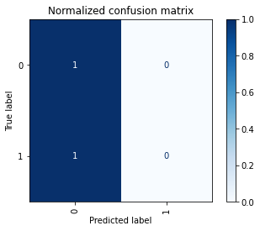
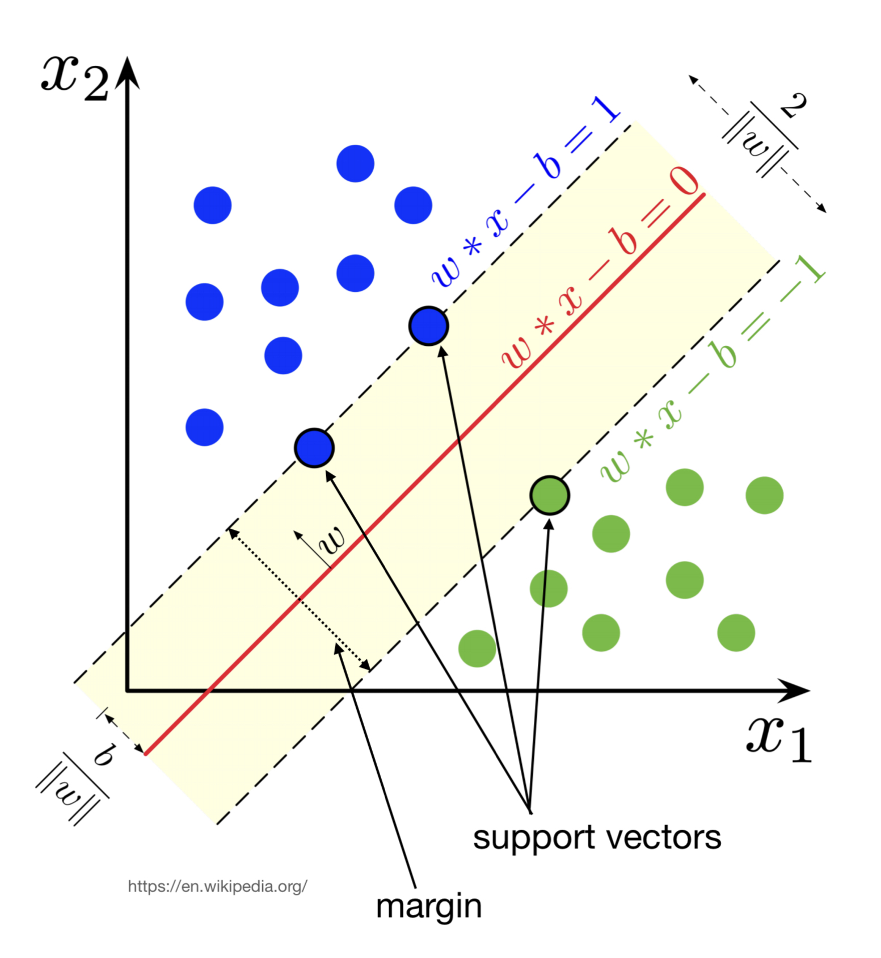
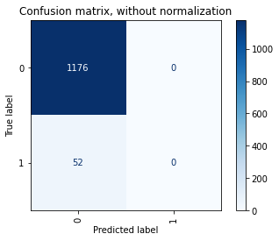
Computer Science Department
Final Project: Project title
Course: Introduction to AI (CS156)
Course Instructor: Yulia Newton, Ph.D.
Bernard Tan
SJSU ID : 015215317
Introduction/Background
Methodology
Analysis and Results
Stroke is a condition in which the arteries leading to and inside the brain get blocked. It is the fifth largest cause of death and a major source of disability. When a blood vessel carrying oxygen and nutrients to the brain is either blocked by a clot or breaks, a stroke occurs (or ruptures).
There have been other previous solutions to prevent it such as quit smoking, limit alcohol use, keep a moderate weight, and get regular checkups People who suffer from this disease and company who work in medical field want to predict, prevent, and improve the accuracy that leads to the disease by using the help of AI.
One of the ways for AI to help would be to test the correspondents in lab with the equipment needed. After receiving the data from the machine, it will be inputted and let the AI predict it.
I agree with this approach as we need many data to get the high accuracy result.
Algorithm
The Machine Learning algorithm used for this project is the Linear Support Vector Machine. This is the best fit for this project, as it is a supervised ML, and the goal is to solve binary classification problems. The program takes data and the result and learns from it to decide whether it is an indication of stroke or not.
Validation/cross-validation results
The trained model performance is measured on a percentage. Cross-Validation is used, and it is divided into 5 folds. The result of each folds are obtained individually. The average of the Cross-Validation accuracies is also calculated.
Individual Cross-Validation Accuracies :
1st Fold : 96 %
2nd Fold : 96 %
3rd Fold : 96 %
4th Fold : 96 %
5th Fold : 96 %
Mean Cross-Validation Accuracies : 96 %
Figure 3: Confusion Matrix with Normalization
Training results
The performance of the training set is calculated as a percentage. The Support Vector Classifier's performance is determined by its accuracy (SVC).
Linear SVC Accuracy on Training Set : 96 %
Summary/Conclusions
In conclusion, the model performance seems acceptable.
More data for the model to be examined may be gathered, allowing more training data variance to be analyzed and the LibLinear library result to converge with an 80:20 train:test split.
With a sufficient amount of data on each fold, the cross-validation iteration could also be raised.
If given more time, I will focus on improving the true stroke accuracy. It is better to falsely predict a non-stroke indication as true stroke rather than the opposite.
Future To-Do List :
1.Obtained more data
2.Find better data transformation
Figure 1: A 2D Maximum Margin Hyperplane on Support Vector Machine. On this project, the machine solves a 11-dimension problem, and the hyperplane would be on 11 dimension too.
Dataset description
Test results
The performance of the test set is calculated as a percentage. The Support Vector Classifier's performance is determined by its accuracy (SVC).
Linear SVC Accuracy on Test Set : 96 %
Independent Variables (11 Total) :
Id = unique identifier of correspondent (Numeric)
Gender = sex of correspondent (Categorical)
Age = Age of correspondent (Numeric)
Hypertension = Hypertension of correspondent (Numeric)
Heart_disease = Heart disease of correspondent (Numeric)
Ever_married = Marital status of correspondent (Categorical)
Work_type = Work type of correspondent (Categorical)
Residence_type = Residence type of correspondent (Categorical) Avg_glucose_level = Average glucose level in blood (Numeric)
Bmi = Body mass index (Numeric)
Smoking_status = smoking status of correspondent (Categorical)
Dependent Variable (1 Total) :
stroke = The prediction of the Stroke (Binary Categorical)
The dependent variable is a proxy that is aimed to predicted. Based on variable, this is a classification problem. The number of classes is 2.
Data Split :
The data split is using the cross-validation approach, with train : test split of 75:25. The split is also stratified so that the data can be distributed more equally for this kind of health prediction.
Application to the project
Before the algorithm was applied, there was some transformation to the data.
First, strings category data such as Gender, Ever_married, Work_type, etc., were replaced with a numeric representation. It is better to work on the same data type (numbers). This replacement is chosen rather than one-hot encoding, as one-hot dimension will create a lot of additional dimensions.
After that, the data for the independent variables is rescaled with the Standard Scaler. This function scales the data to an acceptable range for the algorithm after standardizing it (setting the data distribution Standard Deviation to 1).
The data is supplied to the algorithm to learn and decide from once it has been rescaled.
Key References
[1] Hale, Jeff ; “Scale, Standardize, or Normalize with Scikit-Learn” in Towards Data Sicence, 2019.
[2] Pandas Documentation; “pandas.DataFrame.replace”
[3] Fedesoriano. “Stroke Prediction Dataset.” Kaggle, 26 Jan. 2021, https://www.kaggle.com/datasets/fedesoriano/stroke-prediction-dataset.
Acknowledgements
Thank you, Professor Yulia Newton, for giving the important study materials this semester so that I can learn many things and use them to finish this project.
Figure 2: Confusion Matrix without Normalization

